Slide 1
Marketing Revenue Prediction A Presentation by Sitmang Engshime Peter Link: https://github.com/shiwerdtata/BMI

Slide 2
INTRODUCTION
Objective: This project is primarily focused on providing answers to some pertinent business questions by measuring leading parameters influencing revenue generation as well as proffering handy solutions to the company’s marketing team using machine learning.
The data at our disposal is collected from ACE Inc. for the purpose of the project. The data set were however presented in isolation but we are able to merge them successfully together
The dataset consist of a 182 observations and key features such as Date, Week ID, Month Number, Month ID, Day Name, Promo, Year, marketing spend, no of visitors, revenue were identified.

Slide 3
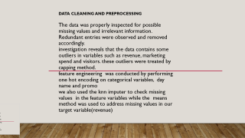
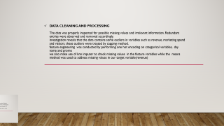


DATA CLEANING AND PREPROCESSING The data was properly inspected for possible missing values and irrelevant information. Redundant entries were observed and removed accordingly. investigation reveals that the data contains some outliers in variables such as revenue, marketing spend and visitors. these outliers were treated by capping method. feature engineering was conducted by performing one hot encoding on categorical variables, day name and promo we also used the knn imputer to check missing values in the feature variables while the means method was used to address missing values in our target variable(revenue)

Slide 4
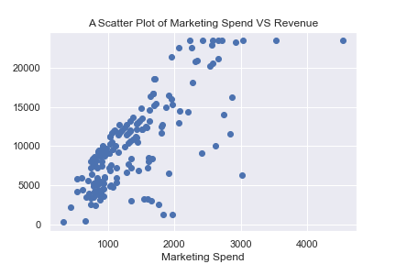
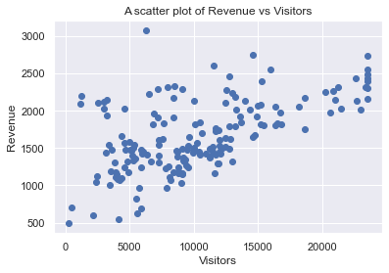
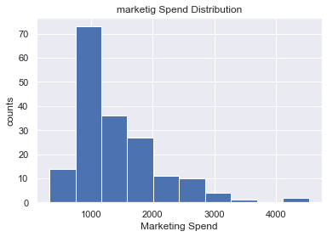
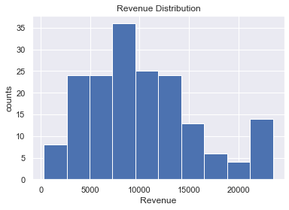

Slide 5
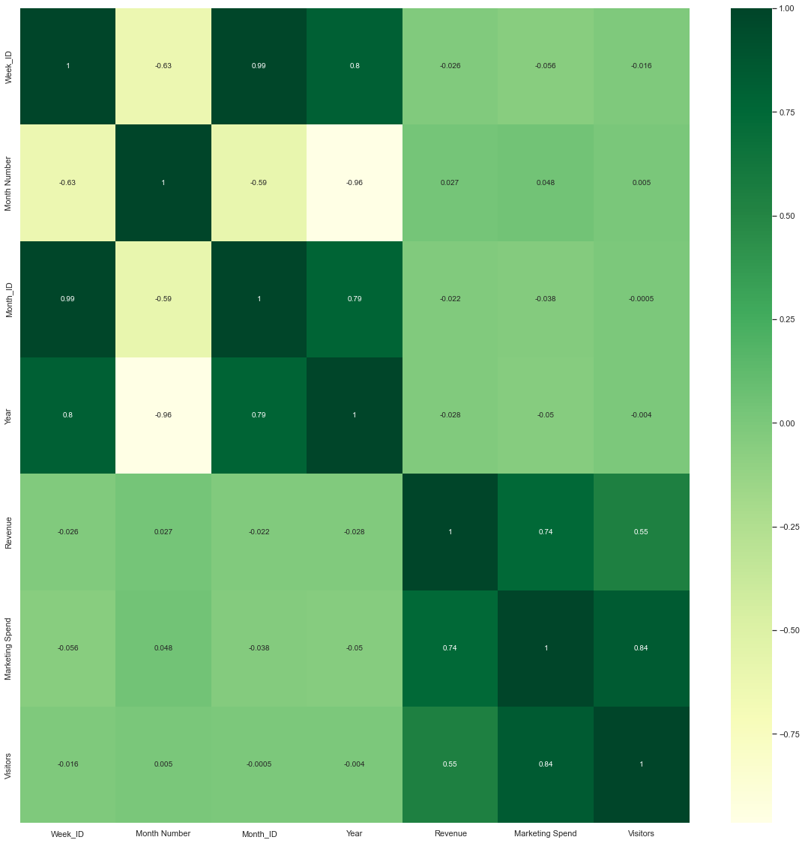
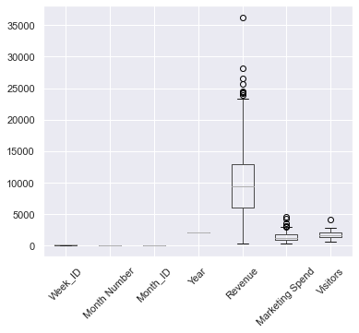

Slide 6
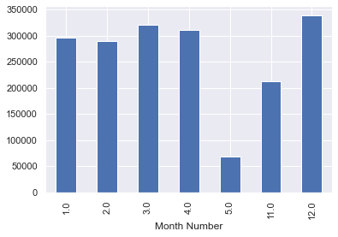
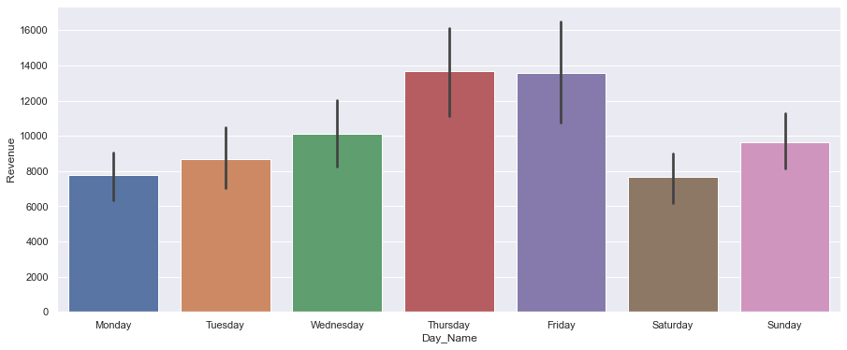
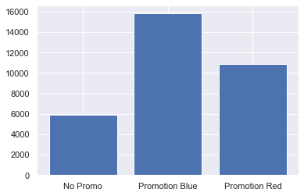
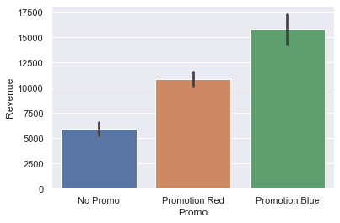
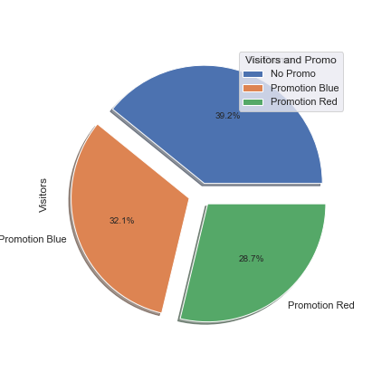
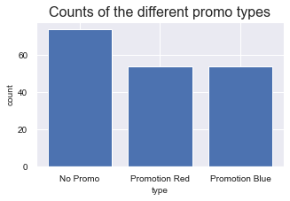

Slide 7
MACHINE LEARNING
Machine learning is a step into the direction of artificial intelligence(AI)
It makes the computer learns from studying data. machine learning is a program that analyses data and learns to predict the outcome. data splitting into features and target variables was done as required. 80% of the data was assigned for training and 20% was set aside for testing, the data was also scaled to standard.
we use the data to train and fit the regression model. the models are as follows ; Linear Regression, KNeighborsRegressor, RandomForest, DecisionTreeRegressor.A number of models were employed for testing the goodness of fit (performance) Linear regression model however, performs optimally compare to others. because it offers a low bias/variance tradeoff.

Slide 8
Results/recommendations Proper analysis shows that marketing spend and visitors top the list of most important drivers of revenue because it provides a greater impact on the revenue compare to others. Linear regression model was 73% correct in predicting the training data and the test data was predicted with about 73% precision. this is a good estimate since it suggests an optimal result with low bias and low variance If we spend #5000 on a Friday, we will expect a revenue growth of about #21180.38 Suppose that we maintain promotion blue throughout the campaign our revenue would have increase by #2531321.71 This is quite a huge gain and must be prioritized to ensure the company’s success.

